Slide 1
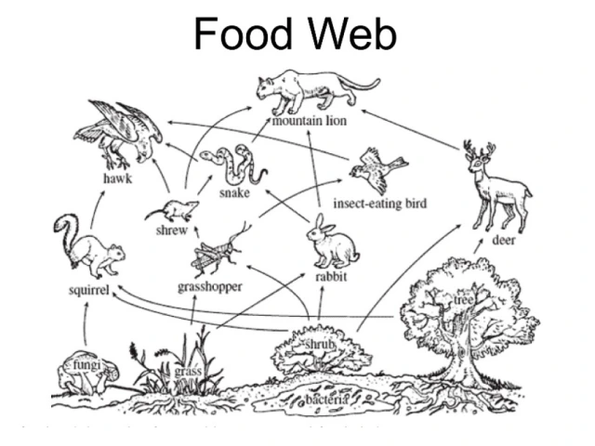
Food Web Revision Name: ______________
Use the food web above to answer the following questions:
Q1. For each of these food chains, state whether it is correct or incorrect. If incorrect, explain why.
Q2. Write a food chain that has five organisms.
Q3. Where do the producers get their energy from?
Food Chain | Correct or Incorrect | Why?
Tree → deer → mountain lion
Grasshopper → shrew → hawk
Fungi ← squirrel ← hawk
Grass → rabbit → snake

Slide 2
Q4. Someone cuts down the trees in the forest. State what happens to the populations of following organisms and explain why.
Organism | Increase or Decrease | Why?
Deer | Decrease | Their food source has decreased so the deer numbers will go down because they won’t have as much food.
Mountain lion
Squirrel
Q5. There is a sudden increase in the number of snakes. State what happens to the populations of following organisms and explain why.
Q6. What happens to the bodies of the hawks and mountain lion when they die? How is this useful to the producers in the food web?
Organism | Increase or Decrease | Why?
Shrew
Mountain lion
Grasshopper

